Slide 1
Segmenting the Crossfit Boxes of Budapest
A data science capstone project by Peter Bazsa

Slide 2
Business introduction and key question
What is Crossfit and where can it be done?
Crossfit is a relatively new fitness direction, basically functional fitness where the goal is to prepare your body for any physical challenge. This sport is done in places called Boxes. These are not like regular gyms, they need special floor, special equipment, therefore this functional fitness cannot be done everywhere.
Crossfit in Budapest, Hungary
Crossfit was established in Hungary in the early 2013 with only a few boxes. There is a difference between the original Crossfit Boxes and the other places, so called Cross-training gyms. The main difference is the name, therefore the brand that it represents. Only those boxes, who bought the license can use the name Crossfit. In this project, I only investigate the licensed boxes, because these are the traditional Crossfit Boxes.
Is it possible to predict the potential places for the new Crossfit Boxes based on only the location data?
For all who are thinking about establishing a new box, this question is the first one that comes into their mind. There are many-many variables that determines the starting point of the boxes, but the location is the first question that need to be answered.

Slide 3
Methodology
Data
Based on the neighborhood and Crossfit box names and locations, the Foursquare API can give useful customer feedbacks
These feedbacks can be used to segment them, to find patterns among them and then cluster them based on their attributes
Those who are similar to a Crossfit box, can be a good choice to establish a new one
Model
It is an unsupervised learning problem which an be solved one of its model. The choice is the Kmeans algorythm
The algorythm is an iterative one, the first try will not be the sufficient one, it requires more iteration and then select the proper value for K
The result of the clustering can answer the question of the project

Slide 4
Data wrangling
Data
The neighborhood names of Budapest ← needed the proper format!
Names of the Crossfit Boxes of Budapest ← needed to create my own dataset, because there is no available data for this
These two list of names can be the feed to the Geolocator API → location coordinates (latitude and longitude values)
After the latitude and longitude values are done, the next step is to feed the Foursquare API to get the user feedbacks
These feedbacks will be the data feed for the chosen model

Slide 5
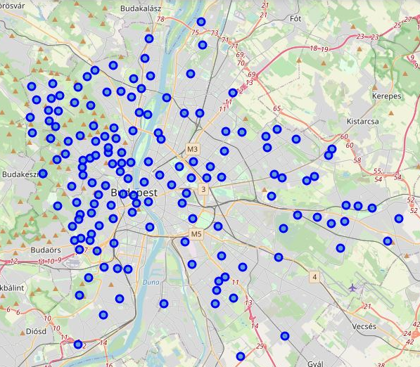
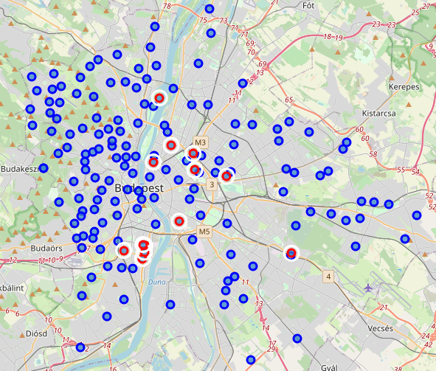
Data analysis
Data
There are 164 different neighborhoods in Budapest, also there are 12 Crossfit Box
Based on the Foursquare feedbacks, most of the neighborhoods have the most common venues as bus stops, grocery store or playground
Visualizing the neighborhoods of Budapest for the purpose of distribution among the city, and doing the same after adding the Crossfit Boxes (red markings with white circles)
The population is very divers, but it is clear that each of the box is trying to place themselves to be close to the inner city, or other crowded areas

Slide 6
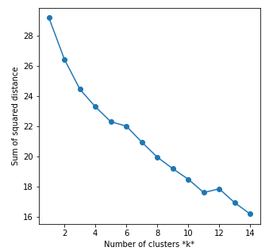
Modelling – assumption and process
Kmeans algorythm
The goal of this model is to find similar attributes among the neighborhoods like a Crossfit box.
If a neighborhood belongs to a cluster which contains at least one Crossfit Box, then it can be a good place to establish one
As the diagram represents, there is a high reduction trend at the beginning in the Sum of Squared distance values.
It stops around the k = 11 value, therefore the proper value for k for the model will be 11

Slide 7
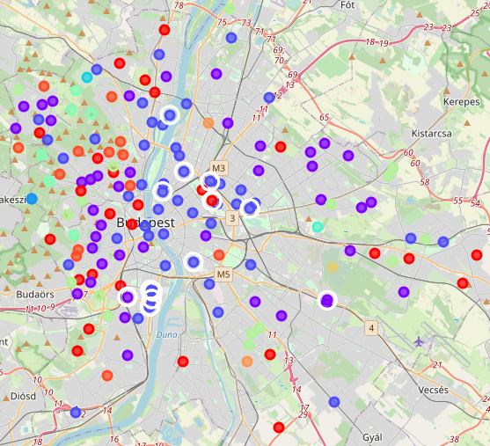
Modelling - results
Kmeans algorythm
Cluster population (majority of the neighborhoods):
Cluster 2 (dark blue markings): 55
Cluster 1 (red markings) : 42
Cluster 0 (purple markings): 23
Cluster 7 (green markings): 16
Cluster 10 (orange markings): 13
Cluster 2, 1 and 0 contains Crossfit Boxes, therefore, the members of these cluster can be a potentially good place to start a Crossfit Box
Most of these markings belongs to the crowded areas, like inner city
There are 45 neighborhoods, which belongs to the first cluster, some of them are already close to a box
The suggestion is to take a neighborhood which is a member of this cluster, but it located further away from the boxes

Slide 8
Summary
The question for the business is: Is it possible to predict the potential places for the new Crossfit Boxes based on only the location data?
Using the customer feedbacks of Foursquare, it is possible to find patterns
In Budapest there are 164 neighborhoods and 12 Crossfit Box, the purpose is to find common attributes among them
The population distribution is very divers among the city, but based on the visualization, most of the Crossfit Boxes are trying to be as close to the crowded areas as they can, like the inner city
To find the patterns I used an unsupervised learning technique, namely Kmeans clustering
Because of the nature of the algorithm, I have to run it iteratively with different value for K to firstly find the proper value for that
It turned out that for this dataset, the proper value for K is 11
After the clustering process, there are 3 clusters which contains at least 1 Crossfit Box, but most of them belongs to the 2nd cluster
In the 2nd cluster, there are 45 neighborhoods which means there are 45 potentially good places to start a Crossfit Box
Some neighborhoods are already close to a box, so the suggestion is to select a neighborhood which is relatively far away from a box, but belongs to this cluster, for instance: Belváros, Kerepesdűlő, Tabán

